Slide 1
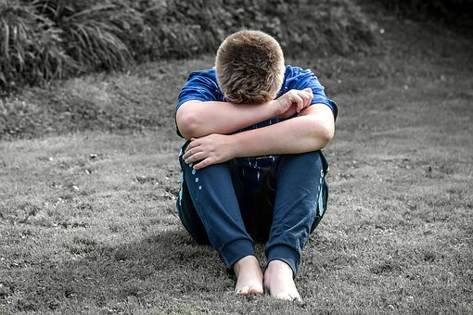

Exploitation course
Copyright Kirklees Safeguarding Children Partnership April 2020

Slide 2

On 23 March 2020 the UK government stepped up measures to prevent the spread of coronavirus and save lives.
Businesses and workplaces should encourage their employees to work at home, wherever possible, people must not meet in groups of more than 2 in public places unless they live together or their job means that they have to. Events have been stopped including Kirklees safeguarding children classroom courses.
Kirklees is now offering online training that will help you to continue to do your day to day role and offer you opportunities for further reading.
Copyright Kirklees Safeguarding Children Partnership April 2020

Slide 3
Aims and Outcomes
Aim:
To explore the agendas of Child Exploitation and Contextual Safeguarding including; Child Trafficking, Child Criminal Exploitation, Children affected by gang activity, Child Sexual Exploitation and Children who go Missing.
Outcomes:
Define Contextual Safeguarding and each of the safeguarding issues
State what the current processes and mechanisms are in place locally and nationally to address the safeguarding issues of Child Trafficking, Child Criminal Exploitation, Children affected by gang activity, Child Sexual Exploitation and Children who go Missing
Explore the current Kirklees Exploitation Safeguarding Strategy
Use examples of current research to inform practice

Slide 4
Working Together 2018
“As well as threats to the welfare of children from within their families, children may be vulnerable to abuse or exploitation from outside their families. These extra-familial threats might arise at school and other educational establishments, from within peer groups, or more widely from within the wider community and/or online. These threats can take a variety of different forms and children can be vulnerable to multiple threats, including; exploitation by criminal gangs and organised crime groups such as county lines; trafficking, online abuse; sexual exploitation and the influences of extremism leading to radicalisation.” (pg. 22) - Working Together

Slide 5
Contextual Safeguarding - Definition
Contextual Safeguarding is an approach to understanding, and responding to, young people’s experiences of significant harm beyond their families.
It recognises that the different relationships that young people form in their neighbourhoods, schools and online can feature violence and abuse.
Parents and carers have little influence over these contexts, and young people’s experiences of extra-familial abuse can undermine parent – child relationships.

Slide 6
Contextual Safeguarding Definition continued…
Therefore children's social care practitioners need to engage with individuals and sectors who do have influence over / within extra familial contexts, and recognise that assessment of, and intervention with, these spaces are a critical part of safeguarding practices.
Contextual Safeguarding, therefore, expands the objectives of child protection systems in recognition that young people are vulnerable to abuse beyond their front doors.
Contextual Safeguarding Network 2019

Slide 7


Slide 8

Contextual safeguarding is an umbrella term that covers these safeguarding issues…
Missing
Harmful Sexual Behaviour
Child Criminal Exploitation
Child Sexual Exploitation
Children affected by gang activity
Trafficking

Slide 9
Child Sexual Exploitation - Definition
Child sexual exploitation is a form of child sexual abuse. It can occurs where an individual or group takes advantage of an imbalance of power to coerce, manipulate or deceive a child or young person under the age of 18 into sexual activity in exchange for something the victim needs or wants, and/or for the financial advantage or increased status of the perpetrator or facilitator.
The victim may have been sexually exploited even if the sexual activity appears consensual. Child sexual exploitation does not always involve physical contact, it can also occur through the use of technology.

Slide 10
What is Child Criminal Exploitation?
Child criminal exploitation occurs where an individual or group takes advantage of an imbalance of power to coerce, control, manipulate or deceive a child or young person under the age of 18 into any criminal activity:
  in exchange for something the victim needs or wants.
  for the financial or other advantage of the perpetrator or facilitator.
  through violence or the threat of violence.
  The victim may have been criminally exploited even if the activity appears consensual. Child criminal exploitation does not always involve physical contact, it can also occur through the use of technology. The criminal exploitation of children is not confined to 'county lines' (see slide 12) but can also include other forms of criminal activity such as theft, acquisitive crime, knife crimes and other forms of criminality.

Slide 11
What do we mean by "Gang activity"?
A gang is a relatively durable, predominantly street-based group of young people who:
• See themselves (and are seen by others) as a discernible group;
• Engage in a range of criminal activity and violence;
• Identify with or lay claim over territory;
• Have some form of identifying structural feature; and
• Are often in conflict with other, similar, gangs.

Slide 12
What is County Lines?
County lines is a term used to describe gangs and organised criminal networks involved in exporting illegal drugs into one or more importing areas [within the UK], using dedicated mobile phone lines or other form of ‘deal line’. They are likely to exploit children and vulnerable adults to move and store the drugs and money and they will often use coercion, intimidation, violence (including sexual violence) and weapons.

Slide 13
What is Trafficking?
“Trafficking in persons” shall mean the recruitment, transportation, transfer, harbouring or receipt of persons, by means of the threat or use of force or other forms of coercion, of abduction, of fraud, of deception, of the abuse of power or of a position of vulnerability or of the giving or receiving of payments or benefits to achieve the consent of a person having control over another person, for the purpose of exploitation. Exploitation shall include, at a minimum, the exploitation of the prostitution of others or other forms of sexual exploitation, forced labour or services, slavery or practices similar to slavery, servitude or the removal of organs;

Slide 14


Slide 15
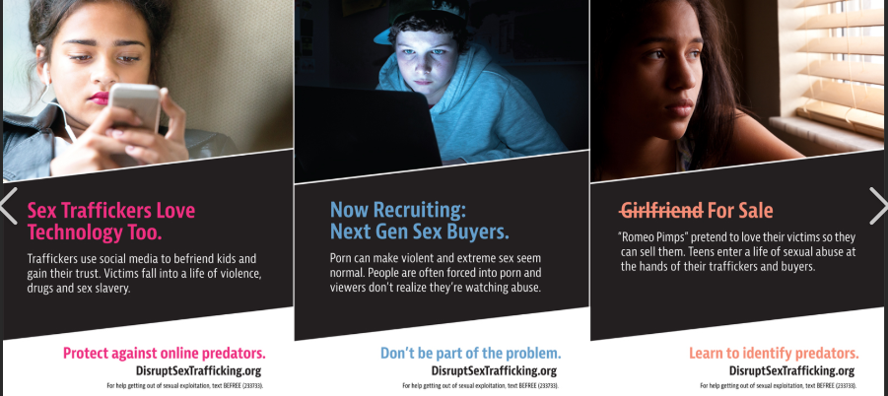
What is Internal Trafficking?
Many children are trafficked from abroad but children can also be trafficked from one part of the UK to another or even one street to another, this is known as internal trafficking

Slide 16
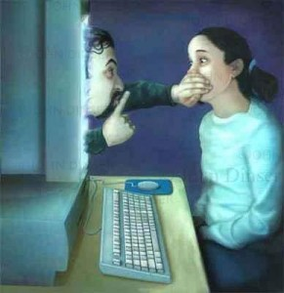
Online grooming/coercion and control
To groom someone is to prepare someone to do something (often but not exclusively) sexual for the benefit of the person making contact.
Online grooming can exert a powerful influence on adolescents through 'virtual' contact and coercion.
Removing or reducing online accessibility is difficult to achieve, as Internet access is everywhere – home, school, Internet cafes etc.

Slide 17
Missing - Definitions
Missing child A child reported as missing to the Police by their family or carers.
Absent Child A child not at a place where they are expected or required to be.
Away from placement without authorisation A Child Looked After whose whereabouts are known but who is not at their placement or place they are expected to be and the carer has concerns or the incident has been notified to the local authority or the Police.

Slide 18
Traditional reach of child protection
Neighbourhood
School
Peer Group
Home
Child
Referral
Planning
Intervention
Screening
Assessment

Slide 19
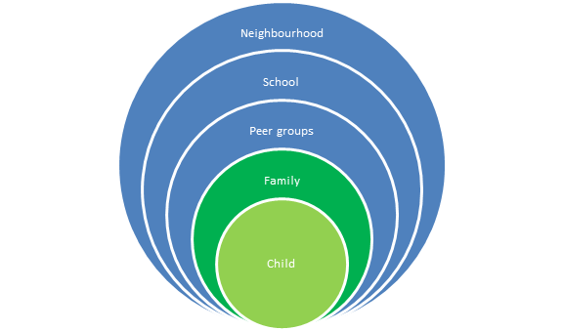
Contextual approach

Slide 20
Partnership working –
Referral and Information
Refer into children’s social care
Schools
Health
Youth and Community
Housing
Licensing
Policing and CJS
Transport

Slide 21

Push Factors
Push Factors - Reasons that could lead to a young person becoming distant from the people who would usually protect them
Living with domestic abuse
Being thrown out of home
Family behaviours and beliefs
Being in a residential or foster placement suffering abuse of any kind
Alcohol or substance misuse within the home
Parents with mental health problems
Having problems at, or not being in school
Being bullied or threatened
Having siblings with difficulties
Being in trouble
Bereavement or significant loss

Slide 22
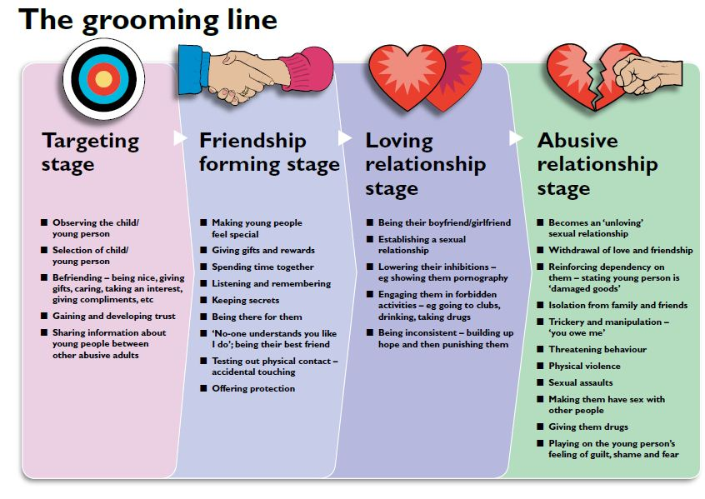

Slide 23

Pull Factors
Pull Factors - The grooming techniques used to gain the young person’s attention, admiration and affection often that often tap into their insecurities or desire for acceptance and status
Receiving alcohol, drugs, money or gifts
Getting a buzz and the excitement of doing something risky or forbidden
Feeling accepted
Being offered somewhere to stay where there are no rules
Being given lifts, taken to new places and having adventures with a casual acquaintance
Being part of an alternative scene,
e.g. criminal gang or music scene
Meeting somebody who thinks they
are special on the internet

Slide 24
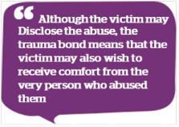
What is trauma bonding?
The term ‘Trauma Bond’ is also known as Stockholm Syndrome. It describes a deep bond which forms between a victim and their abuser.
Victims of abuse often develop a strong sense of loyalty towards their abuser, despite the fact that the bond is damaging to them.
Conditions necessary for trauma bonding to occur include:
To be threatened with, and to believe, that there is real danger
Harsh treatment interspersed with very small kindnesses
Isolation from other people’s perspectives
A belief that there is no escape
The symptoms of trauma bonding can manifest:
Negative feelings for potential rescuers
Support of abusers reasons and behaviours
Inability to engage in behaviours that will assist release/ detachment from abusers.

Slide 25
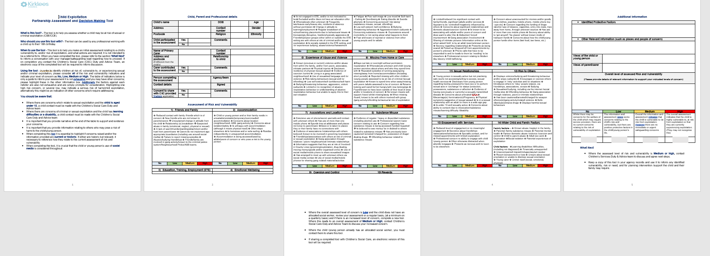
Child Exploitation Partnership Assessment and Decision - making tool

Slide 26
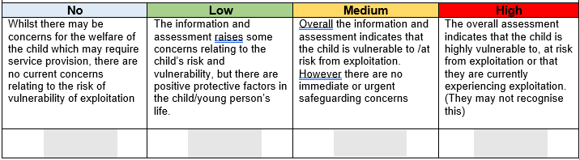
Next steps
Where the assessed level of risk and vulnerability is Medium or high, contact Children’s Services Duty & Advice team to discuss and agree next steps.
Keep a copy of this tool in your agency records and use it to inform any identified vulnerability, risk or need, and for planning intervention /support the child and their family may require.

Slide 27
Referring Exploitation concerns to Duty & Advice
There must be a completed Child Exploitation Partnership Assessment and Decision - making tool form.
This must provide explicit detailed evidence of any concerns of exploitation – who, what, where and how are the risks causing concern?
This will allow Duty & Advice to complete basic information checks if the risk level is medium or high to prevent further harm.
This may then lead to further checks to be completed and possibly to contact the family i.e ‘Child Contact’ record on Liquid Logic – this may lead to advice or sign posting to specific service supports (medium risk).
‘High Risk’ may result in the case being stepped up to social care and would be allocation of a social worker, who may refer to the ‘MACE’ process.

Slide 28
Multi Agency Child Exploitation ‘MACE’
Multi agency child exploitation process provides a specific layer of scrutiny within social care to identify, assess and collate intelligence of exploitation activities within the local area and to protect young people at risk.
Young people can be ‘nominated’ to the MACE meetings as individuals of concern but must have a social worker allocated to them.
The needs of identified young people will be discussed at regular MACE meetings and plans instigated to support them away from risky places and associations or non-school attendance, gangs, missing episodes and will be reviewed regularly.
MACE meetings focus on the individual young person; within the MACE process, there is also the facility to consider Contextual Safeguarding which looks at themes of concern – places, groups, mapping ‘hot spots’ of interest that indicate possible exploitation – county lines, money laundering, trafficking. Intelligence is gathered and shared with other professional agencies who can then coordinate a multi-agency response.

Slide 29
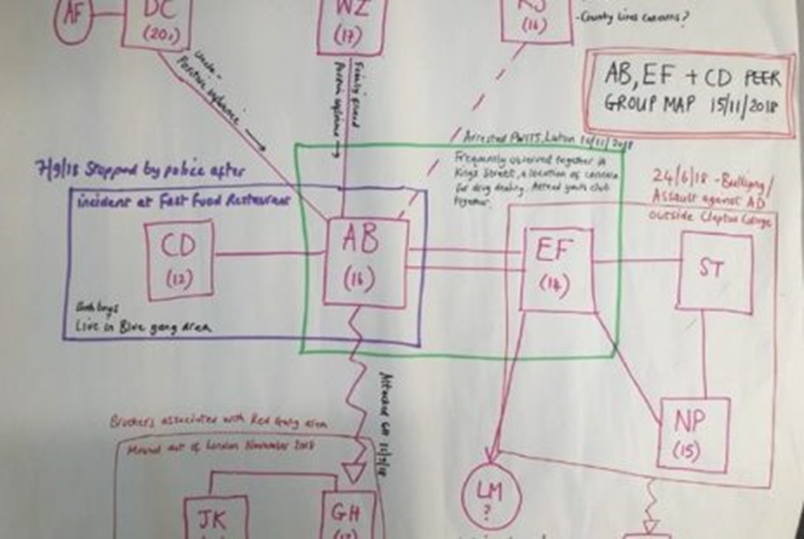
Peer Group Mapping
Peer group mapping provide opportunities for practitioners to understand the relationships between young people and the dynamics of those groups.

Slide 30
Kirklees current reporting mechanisms
If a child or young person goes missing the process would be to contact the Police and Duty and Advice team
If a child or young person is thought to being sexually or criminally exploited contact Duty and Advice team
If a child or young person is thought to be involved in gang activity contact Duty and Advice
If a child or young person was thought to be trafficked contact Police, Duty and Advice and possibly refer on to the National Referral Mechanism (NRM)

Slide 31
National Referral Mechanism
2 stage process
Role of the First Responder
Single Competent Authority
Consent
Where to find the referral forms
The National Crime Agency Police forces UK Border Force UK Visas and Immigration (Home Office)
Gangmasters Licensing Authority Local authorities Health and social care trusts (Northern Ireland)
Salvation Army
Migrant Help Medaille Trust Kalayaan
Barnardo’s Unseen TARA Project (Scotland)
NSPCC Child Trafficking Advice Centre
BAWSO (Wales)
New Pathways
Refugee Council

Slide 32
Digital NRM Form
Available to all First Responders since 29th August 2019.
Accessed via the following link:
https://www.modernslavery.gov.uk/start

Slide 33
Support for Children
Children are supported by the local authority under their duty in the Children Act 1989, not the NRM.
The NRM will provide access to some legal aid and assist in immigration claims or criminal cases where a child has committed an offence as a result of being a victim of modern slavery.
A referral to the NRM is not a child protection referral. This must be done before the NRM form is submitted.

Slide 34
Children & Young People’s Partnership Board
KSCP-Safeguarding Partnership
Exploitation Strategic Group
Exploitation Operational Group
MACE

Slide 35
What is the Exploitation Safeguarding Strategy?
Our Strategic Objectives are:-
Objective 1 Prevent
To prevent children, young people and vulnerable adults experiencing or continuing to experience, exploitation, harm and abuse by ensuring effective awareness-raising and preventative work is in place across the locality, staff benefit form quality learning and development opportunities and that there is an effective response to information and intelligence, that identifies individuals, groups or locations of concern, and highlights patterns or trends.
Objective 2 Prepare
To develop a comprehensive and accurate intelligence picture which will inform local partnership understanding of context, and locations of concern to enable swift coordinated multi-agency responses to safeguard children and prevent, divert or prosecute those who seek to facilitate and /or perpetrate exploitation, abuse and harm.

Slide 36
What is the Exploitation Safeguarding Strategy?
Objective 3 Protect
To develop effective child centred practice and service provision, to protect children, young people, vulnerable adults, families and communities, and ensure positive outcomes for all, whilst empowering individuals to build resilient communities.
Objective 4 Pursue
Use information intelligently to assess and intervene with contexts and groups, to safeguard children and young people and prosecute those who seek to facilitate and /or perpetrate exploitation, abuse and harm; ensuring that a holistic, person centred approach, from intervention, to where necessary prosecution, is adopted and employed.

Slide 37
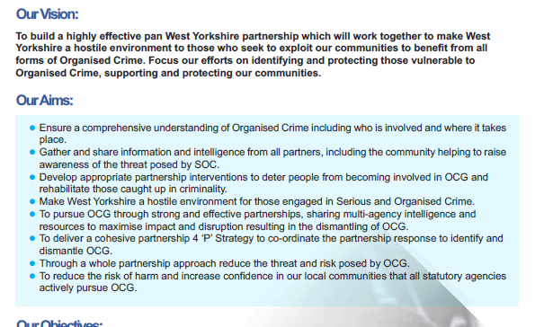
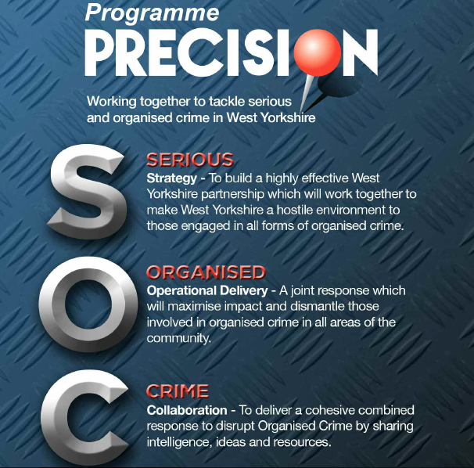
What is the Precision Strategy?

Slide 38
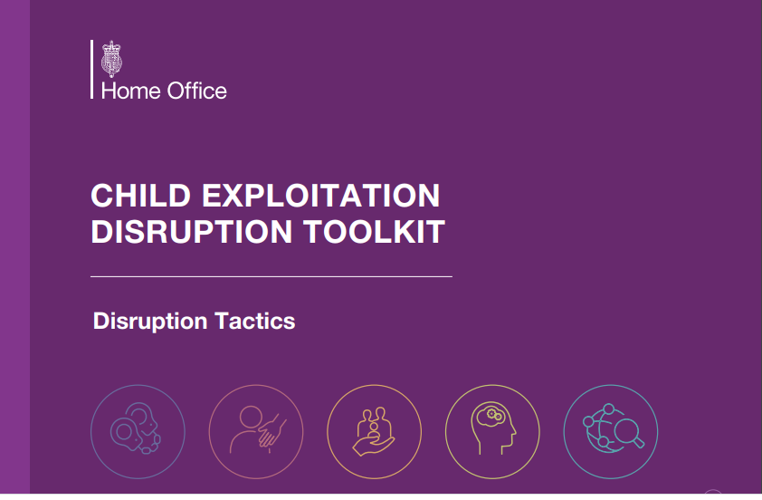

Slide 39
Facts and Myth Busters about criminal exploitation
It isn’t about drugs
Criminal exploitation of children can take many forms. It is often talked about in the news in terms of ‘County lines’– being coerced into moving and selling drugs across the country. However, it also includes being forced to shoplift or pick pocket, work in cannabis factories or threaten other young people.
2.Online music videos are hunting grounds for exploiters
Children can be targeted for exploitation face to face or online through social media and other platforms. Criminal groups will use popular culture such as online music video to contact and groom young people

Slide 40
Continued …
3 All children are at risk no matter what their background
Any child can be at risk of exploitation no matter their family network, social economic background or neighbourhoods. However, certain vulnerabilities can place a child at greater risk. These include growing up in poverty, having learning difficulties, being excluded from school or being looked after.
4. Drugs aren’t only a problem in big cities
Practitioners and Police report increasing awareness of young people being exploited through ‘county lines’, the distribution of drugs around the country using ‘phone lines’. There are thousands of drug trafficking routes to all areas of the country.

Slide 41
Continued…
5. Children as young as seven are being exploited
There is evidence that children as young as seven are being targeted for exploitation. Although older adolescents are more likely to be recorded, many younger children are not recognised and therefore the opportunity to protect them is missed.
6. Signs of exploitation are not obvious
There are many signs to suggest a child is being exploited. One indicator could be if the young person is going missing from home or care. Children in care go missing more frequently than other children and are more likely to be found outside of their boundaries of their home local authority.

Slide 42
Continued ...
7. Exploited children are not treated equally
Gender, age, ethnicity and background can all affect the way professionals respond to children who have been or are at risk of being criminally exploited. Some may be recognised as victims while others are not.
https://www.childrenssociety.org.uk/news-and-blogs/our-blog/7-facts-you-need-to-know-about-child-exploitation

Slide 43
Test yourself
What is contextual safeguarding?
2. Name two ways in which perpetrators may try to groom young people
3. Name three push factors and three pull factors that are used to groom young people
4. Why does trauma bonding occur?
5.What does MACE stand for?

Slide 44
Listen to the audio for the answers from the previous slide

Slide 45
Further reading and references
https://assets.publishing.service.gov.uk/government/uploads/system/uploads/attachment_data/file/794554/6.5120_Child_exploitation_disruption_toolkit.pdf
Children Act 1989 https://www.legislation.gov.uk/ukpga/1989/41/contents
https://www.childrenssociety.org.uk/news-and-blogs/our-blog/7-facts-you-need-to-know-about-child-exploitation
https://www.modernslavery.gov.uk/start
https://www.nationalcrimeagency.gov.uk/what-we-do/crime-threats/drug-trafficking/county-lines
https://paceuk.info
https://www.unodc.org/unodc/en/organized-crime/intro/UNTOC.html

Slide 46
References and further reading continued…
https://www.unodc.org/unodc/en/organized-crime/intro/UNTOC.html
https://www.westyorkshire.police.uk/.../child-sexual-exploitation
https://www.westyorkshire.police.uk/advice/online-crime-safety/online-safety/cyber-crime/online-grooming-child-sexual-exploitation

